Slide 1

Project Title -
Seasonal Agriculture Performance Analysis
Siddharth Sandesh Mahajan
Department of Technology, Savitribai Phule Pune University
AICTE STU ID : STU6976124b6fa351769345611

Slide 2

PROBLEM STATEMENT
Agricultural activities are influenced by seasonal variations in environmental conditions, farming practices, resource availability and market conditions. As a result, agricultural performance may differ from one season to another.
However, raw agricultural data does not clearly explain how agricultural performance changes across seasons or what patterns can be observed in different seasonal conditions.
The problem is to analyze the given agricultural dataset and investigate seasonal differences in agricultural performance by identifying meaningful patterns, trends, relationships and variations within the available data.

Slide 3
Project Description
This project analyzes seasonal agriculture performance using a dataset of 4,000 farming records.
The dataset includes information about crops, seasons, geographical regions, weather conditions, soil properties, irrigation, resource usage, yield, production, revenue, and profit.
The analysis compares agricultural performance across Kharif, Rabi, and Zaid seasons.
It explores the relationship between environmental conditions, farming practices, resource usage, and crop yield.
Key factors such as rainfall, irrigation methods, water efficiency, crop type, and profitability are analyzed using charts and statistical methods.

Slide 4

WHO ARE THE END USERS?
Farmers – To understand seasonal performance and choose suitable crops, irrigation methods, and farming practices.
Agricultural Planners & Government Agencies – To support agricultural planning, resource allocation, and seasonal strategies.
Agribusinesses – To understand crop production, market conditions, and profitability.
Agricultural Researchers – To study relationships between environmental conditions, farming practices, and crop performance.
Data Analysts & Agricultural Consultants – To analyze agricultural trends and provide data-driven recommendations.

Slide 5

Technology Used
  Python
  Pandas
  NumPy
  Matplotlib
  Seaborn
  Jupyter Notebook

Slide 6
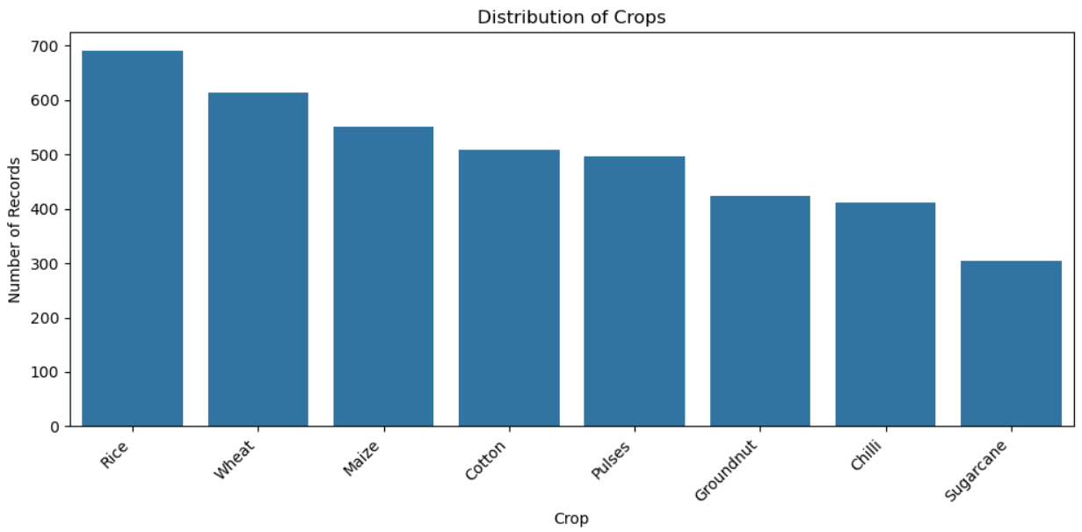
RESULTS

Slide 7
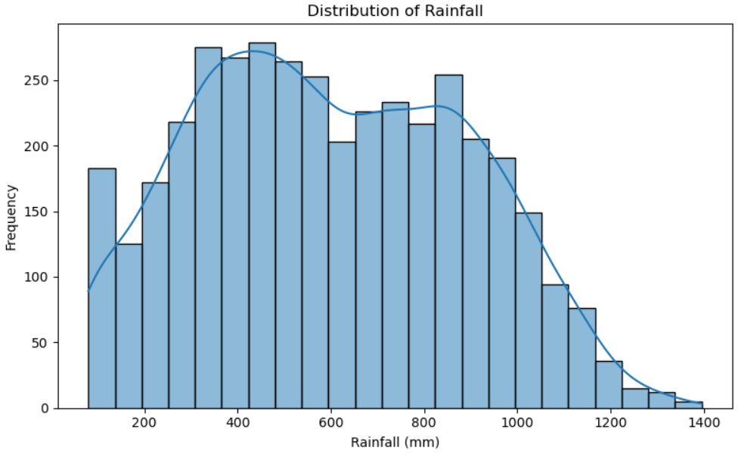
RESULTS

Slide 8
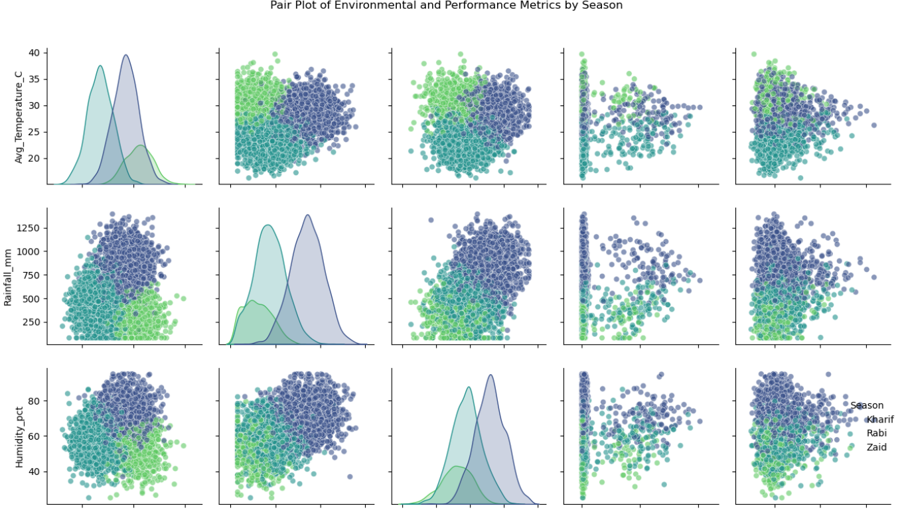
RESULTS

Slide 9
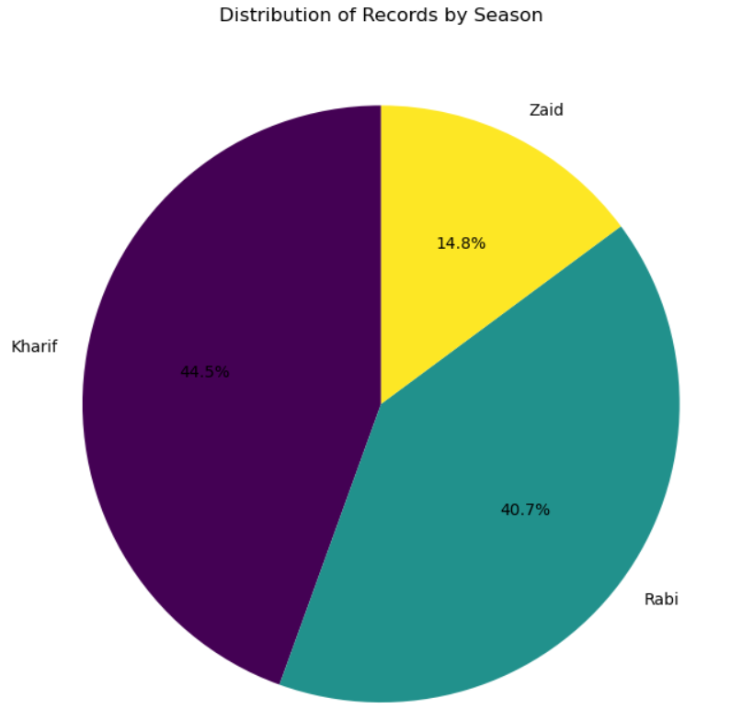
RESULTS

Slide 10
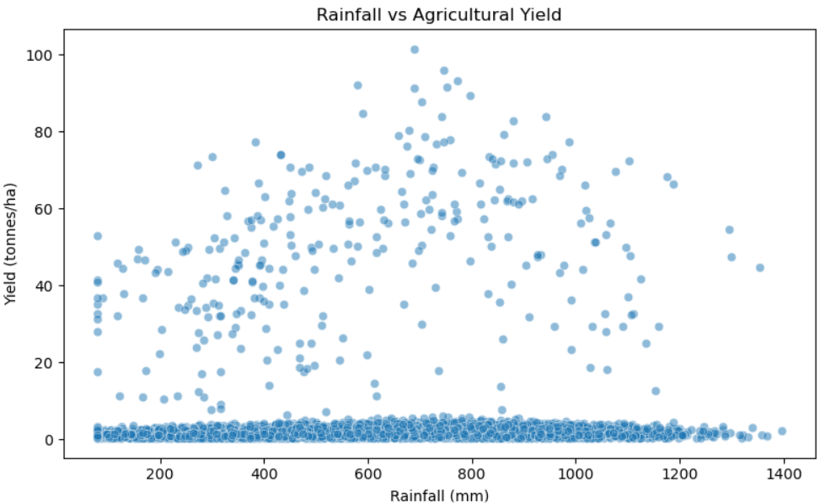
RESULTS

Slide 11
Future scope
Larger & Multi-Year Dataset – Include data from more regions and multiple years to identify long-term agricultural trends.
Crop Yield Prediction – Develop Machine Learning models to predict crop yield based on weather, soil, and farming conditions.
Weather & Market Integration – Use real-time weather forecasts and market prices for more accurate analysis.
Interactive Dashboard – Create dashboards using Power BI or Tableau for easier monitoring and decision-making.
Resource Optimization – Recommend suitable irrigation, fertilizers, and farming practices to improve yield and reduce resource wastage.
Early Risk Detection – Identify potential crop disease, pest, and environmental risks at an early stage.

Slide 12
GitHub Link
https://github.com/siddharthmahajan2477-dot/Seasonal-Agriculture-Performance-Analysis.git

Slide 13

VOIS Course completion certificate -
Course name- Data Visualization

Slide 14
Thank you
.
.

